Slide 1
Feed Corpus :
An Ever Growing Up to Date Corpus
Akshay Minocha, Siva Reddy, Adam Kilgarriff
Lexical Computing Ltd

Slide 2
Introduction
Study language change
  over months, years
Most web pages
  no info about when written
Feeds
  written then posted
Same feeds over time
  we hope
    identical genre mix
    only factor that changes is time

Slide 3
Method
Feed Discovery
Feed Validation
Feed Scheduler
Feed Crawler
Cleaning, de-duplication, Linguistic Processing

Slide 4
Feed Discovery via Twitter
Tweets often contain links for posts on feeds
  bloggers, newswires often tweet
    "see my new post at http..."
Twitter keyword searches
  News, business, arts, games, regional, science, shopping, society, etc.
  Ignore retweets
  Every 15 minutes

Slide 5
Sample Search
Aim - To make the most out of the search results
https://twitter.com/search?q=news%20source%3Atwitterfeed%20filter%3Alinks&lang=en&include_entities=1&rpp=100
Query - News
Source - twitterfeed
Filter - Links ( To get all tweets necessarily with links)
Language - en ( English )
Include Entities - Info like geo, user, etc.
rpp - result per page ( maximum 100 )

Slide 6
Feed Validation
  Does the link lead directly to a feed?
    does metadata contain
      type=application/rss+xml
      type=application/atom+xml
  If yes, good
  If no
    search for a feed in domain of the link
    If no
      search for feed in (one_step_from_domain)
    If still no
      link is blacklisted

Slide 7
Scheduling
Inputs
  Frequency of update
    average over last ten feeds
  Yield Rate
    ratio, raw data input to 'good text' output
      as in Spiderling, Suchomel and Pomikalek 2012
Output
  priority level for checking the feed

Slide 8
Feed Crawler
Visit feed at top of queue
Is there new content?
  If yes
  Is it already in corpus?
      Onion: Pomikalek
    if no
    clean up
      JusText: Pomikalek
    add to corpus

Slide 9
Prepare for analysis
Lemmatise, POS-tag
Load into Sketch Engine

Slide 10
Initial run: Feb-March 2013
Raw:1.36 billion English words
300 m words after deduplication, cleaning
150,000+ feeds
Delivered to CUP
  Keep their corpus up-to-date
Keywords vs enTenTen12
  [a-z]{3,}

Slide 11
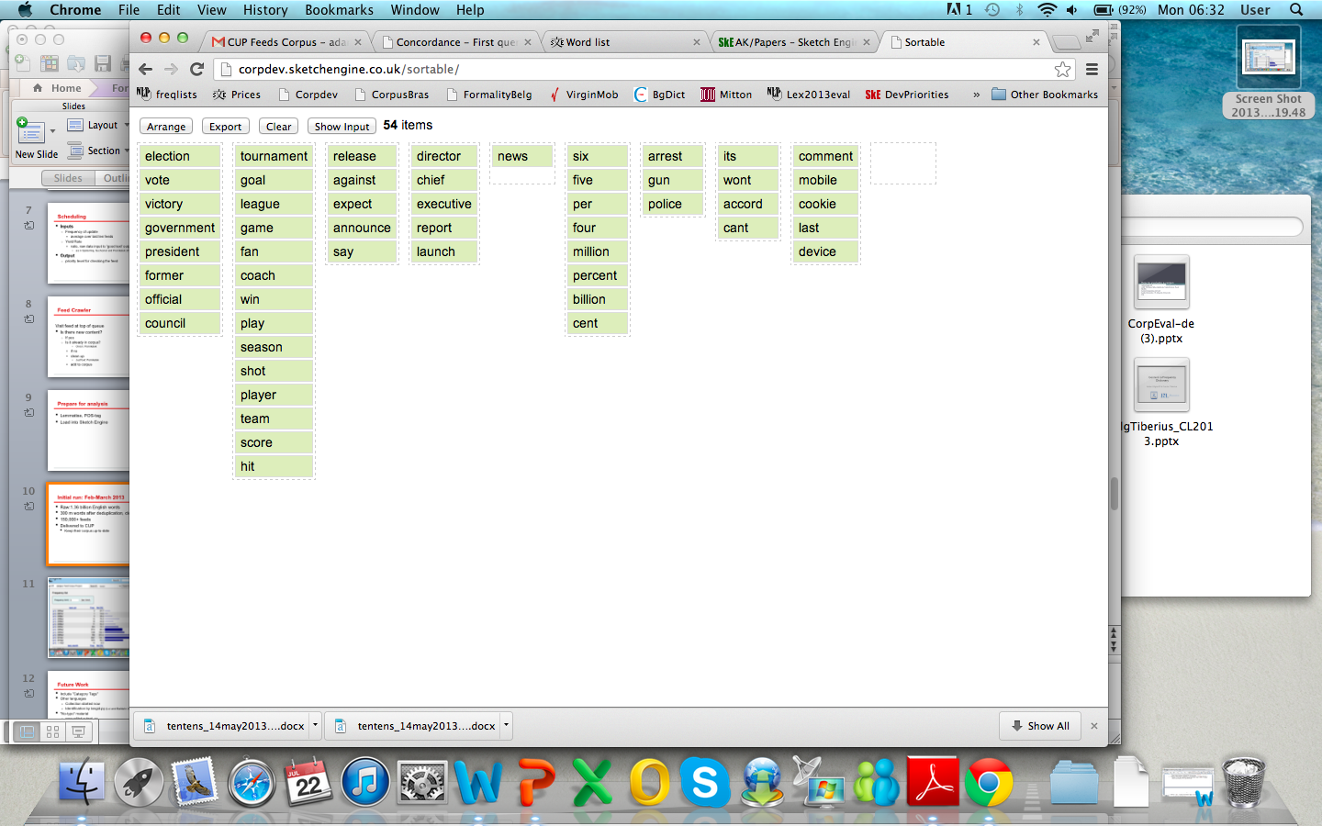

Slide 12
An earlier version
maintenance

Slide 13
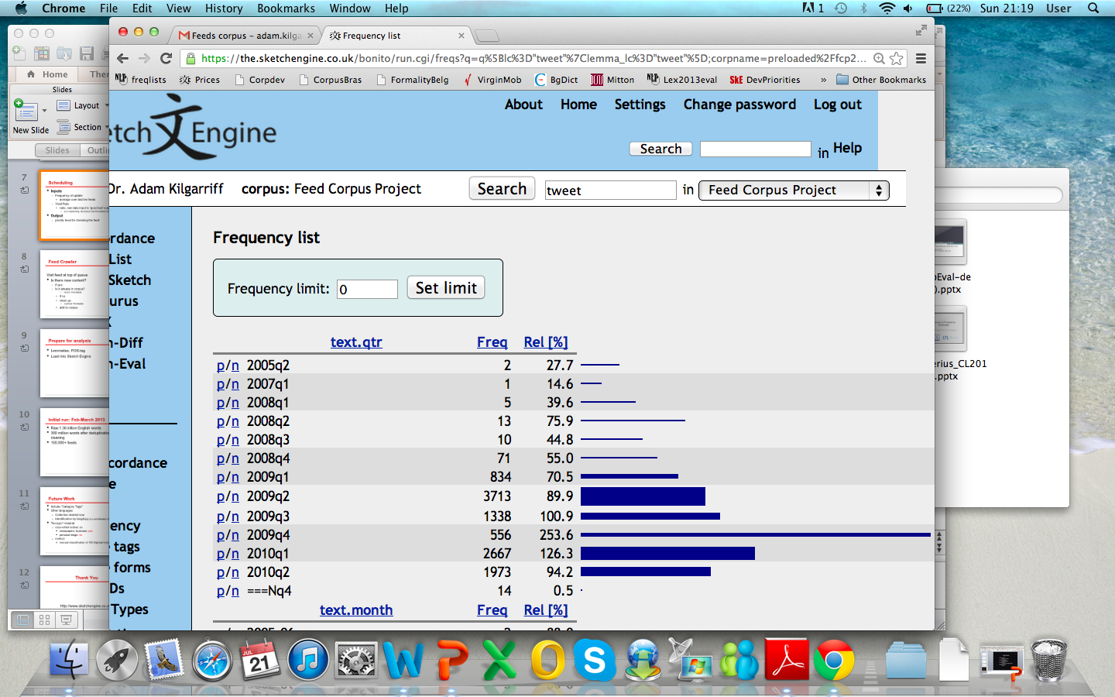

Slide 14
Future Work
MAINTAIN
Include "Category Tags"
Other languages
  Collection started now
  Identification by langid.py (Lui and Baldwin 2012)
"No-typo" material
  copy-edited subset, so
    newspapers, business: yes
    personal blogs: no
  method:
    manual classification of 100 highest-volume feeds

Slide 15
Thank You
http://www.sketchengine.co.uk

